Slide 1
Children and Young People (CYP) CORE20PLUS5 in Herefordshire & Worcestershire
Information Pack
December 2024
Ensuring that tackling health inequalities is everyone’s business

Slide 2
Table of Content
Items | Slide
Core20PLUS5 Framework for CYP Population | 3
CYP Population Health Herefordshire (MYE2022) | 4
CYP Population Health Herefordshire (Sept 2023) | 5
IMD Areas by LSOAs in Herefordshire 2019 | 6
Obesity Rate Among CYP Population in Herefordshire | 7-11
CYP Population Health Worcestershire (Sept 2023) | 12
Age Distribution of CYP in Worcestershire | 13
Ethnicity Distribution of CYP in Worcestershire (2021 census) | 14
Distribution of Vulnerable Children by IMD Decile in Worcestershire | 15
Percentage of Children Living in Poverty for Districts in Worcestershire | 16-17
Obesity Rate Among CYP Population in Worcestershire | 18
Maps Showing IMD Quintiles for Districts in Worcestershire | 19-25
Core20PLUS5 Clinical Areas of CYP in Worcestershire and Herefordshire | 26-33
Ensuring that tackling health inequalities is everyone’s business

Slide 3
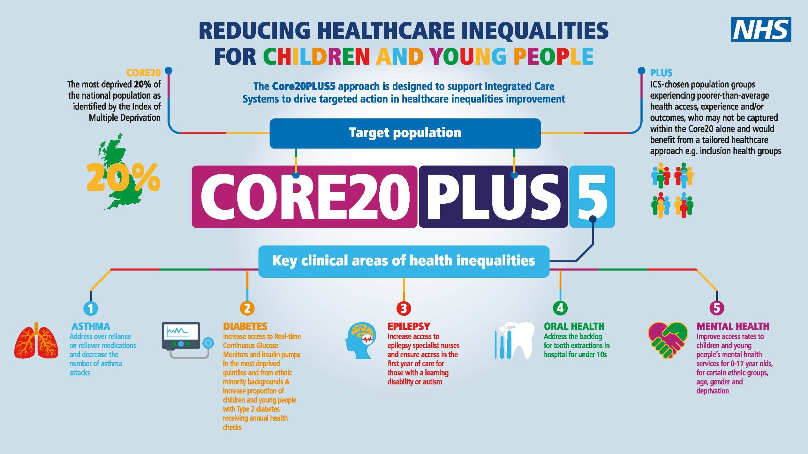
This pack provides Herefordshire and Worcestershire information within the context of the national CORE20PLUS5 framework for Children and Young People (CYP).
Purpose:
Please use the information in this pack to identify where to focus efforts when undertaking targeted work.
As a system, if we all target our efforts to areas and groups experiencing the greatest inequalities, collectively we can have a greater impact.
Ensuring that tackling health inequalities is everyone’s business

Slide 4
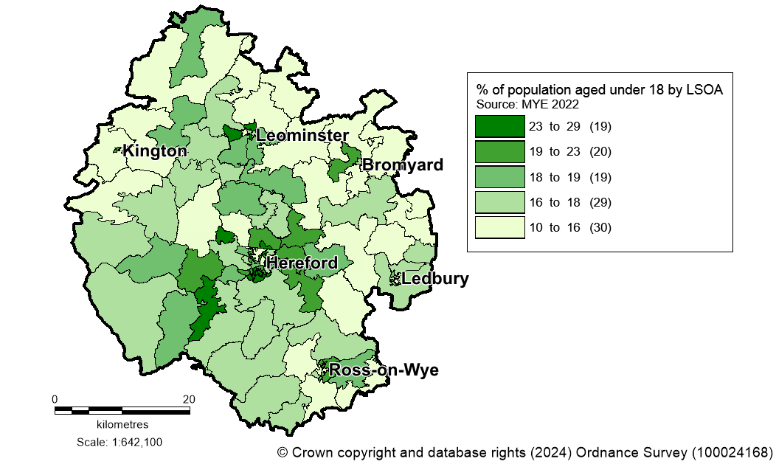
CYP Population in Herefordshire (MYE 2022)
Current population
34,000 under 18s live in Herefordshire
18.0% of the county population
The areas with the largest population of under 18s include:
Golden Post/Newton Farm (29%)
Newton Farm/Brampton Road (26%)
Putson (26%)
Ridgemore (26%)
Map showing CYP by LSOA (MYE 2022)
Ensuring that tackling health inequalities is everyone’s business

Slide 5
Herefordshire: CYP Population Health 2023
Ensuring that tackling health inequalities is everyone’s business

Slide 6
Areas of Herefordshire that are Amongst the Most Deprived Nationally According to the IMD 2019
7 LSOAs in Herefordshire are ranked as quintile 1 (most deprived 20%) of the Income Deprivation Affecting Children Index (IDACI). These areas are shown on the map and table below.
2,480 0-15 year olds live in these 7 LSOAs (8% of under 16 population)
LSOA Code | LSOA Local Name | Town/City
E01013993 | Newton Farm-Brampton Road | Hereford
E01013995 | Golden Post - Newton Farm | Hereford
E01014042 | Leominster - Ridgemoor | Leominster
E01014044 | Leominster - Barons Cross | Leominster
E01014047 | Leominster - Gateway | Leominster
E01014064 | Ross - John Kyrle | Ross-on-Wye
E01014085 | Moor Farm & Whitecross | Hereford
Source: Department for Levelling Up, Housing and Communities)
Ensuring that tackling health inequalities is everyone’s business
Source: Herefordshire Council Intelligence Unit

Slide 7
Obesity in Herefordshire
North Leominster was the MSOA with the highest proportion of overweight or obese YR children (36%), whilst Bromyard and Bishop’s Frome had the smallest proportion of overweight or obese YR children (18%).
Source: Department for Levelling Up, Housing and Communities)
Ensuring that tackling health inequalities is everyone’s business
Source: Herefordshire Council Intelligence Unit

Slide 8
Obesity in Herefordshire
South Leominster was the MSOA with the highest proportion of overweight or obese Y6 children (48%), whilst Kingstone and Kingsthorne had the smallest proportion of overweight or obese Y6 children (27%).
Source: Department for Levelling Up, Housing and Communities)
Ensuring that tackling health inequalities is everyone’s business
Source: Herefordshire Council Intelligence Unit

Slide 9
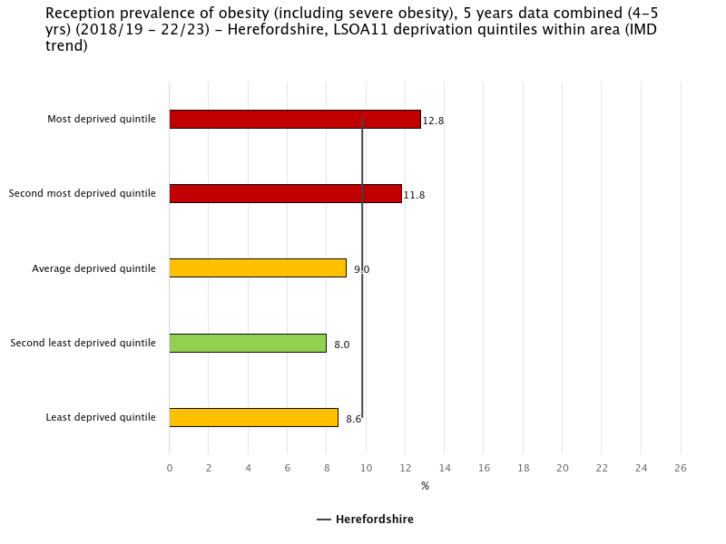
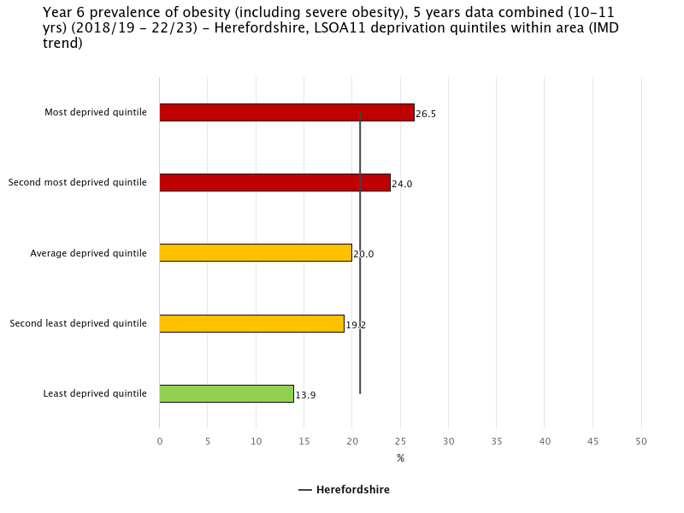
Obesity and Deprivation in Herefordshire
The most deprived areas of Herefordshire have consistently seen significant higher rates of obesity since 2009/10 – 2013/14.
(source Fingertips and NCMP data)
Ensuring that tackling health inequalities is everyone’s business

Slide 10
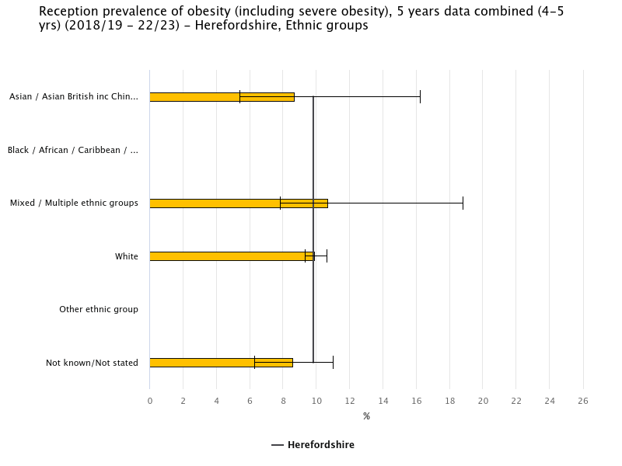
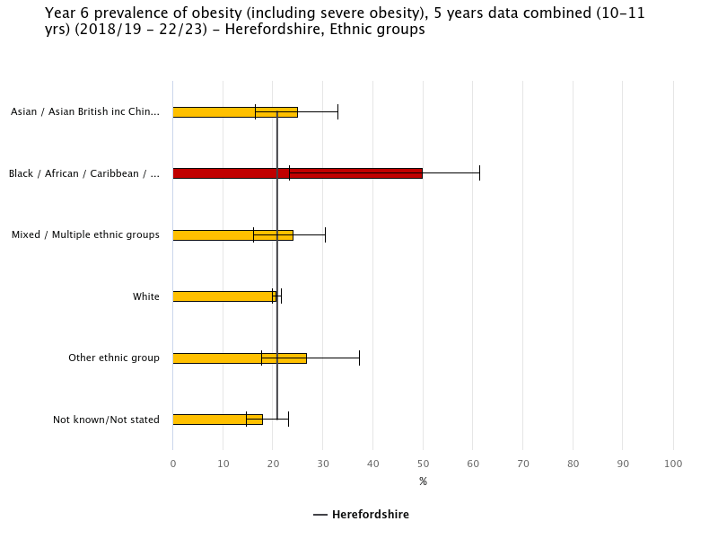
Obesity Split by Ethnicity in Herefordshire
The link between ethnicity and obesity is less apparent in Herefordshire than it is nationally. The only significant difference that has been seen since 2009/10-2013/14 was black children in Year 6 had significantly higher rates of obesity compared to the average for all children in 2018/19-2022/23. The large confidence intervals seen in the graphs above suggest that the reason there is only a weak link between ethnicity and obesity in Herefordshire could be due to statistical constraints due to the small number of non-white children being measured as part of NCMP.
(source Fingertips and NCMP data)
Ensuring that tackling health inequalities is everyone’s business

Slide 11
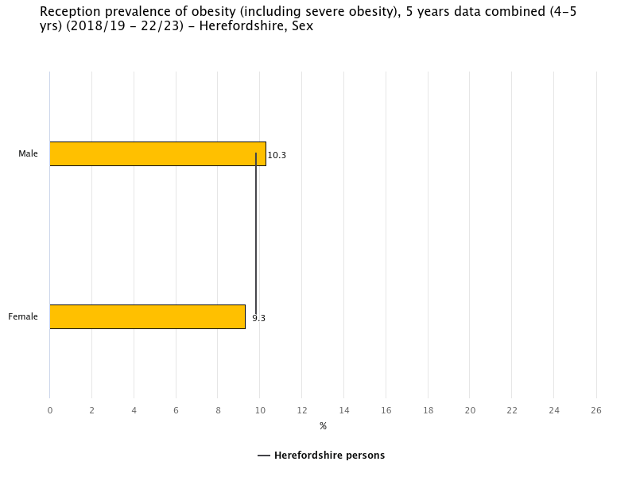
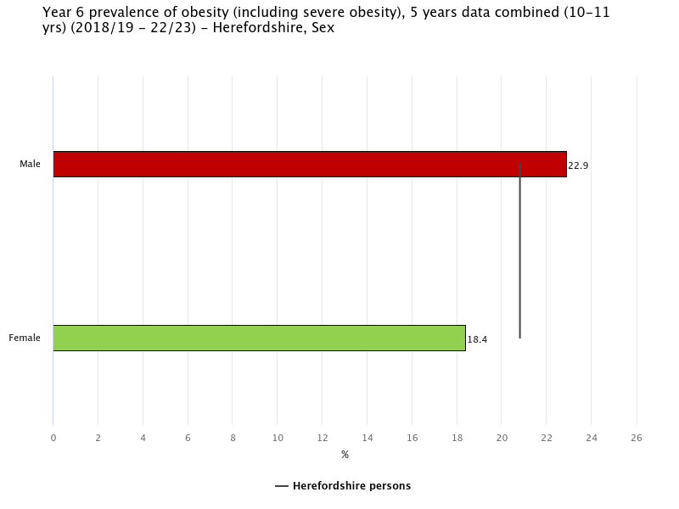
Obesity Split by Gender in Herefordshire
The graphs above show that in 2018/19-2022/23 there was no significant difference in the prevalence of obesity between male and female students when in reception class, but male students are significantly more likely to be obese by year 6. This pattern can be seen in every time period dating back to 2009/10-2013/14 suggesting a long standing inequality between the sexes once they get to year 6.
(source Fingertips and NCMP data)
Ensuring that tackling health inequalities is everyone’s business

Slide 12
Worcestershire: CYP Population Health (Sept 2023)
Ensuring that tackling health inequalities is everyone’s business

Slide 13
Adapted from Worcestershire County Council: Microsoft Power BI
Ensuring that tackling health inequalities is everyone’s business

Slide 14
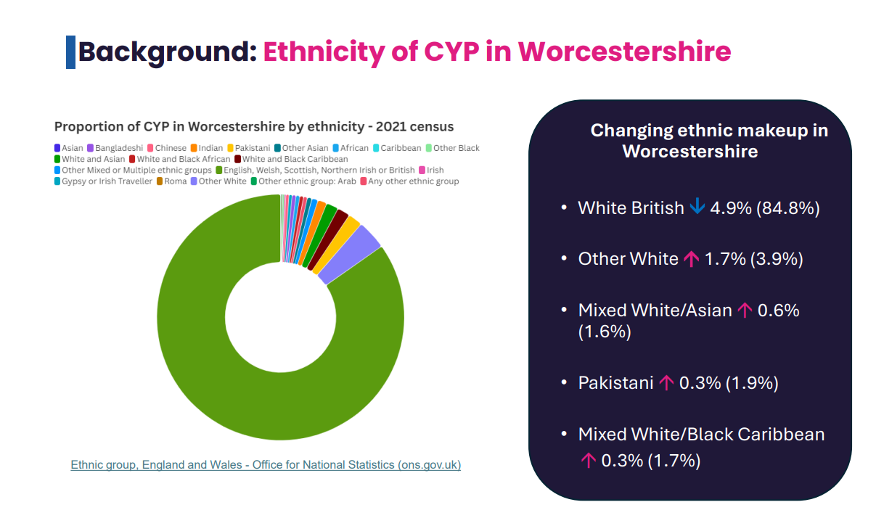
Ethnic group, England and Wales - Office for National Statistics
Ensuring that tackling health inequalities is everyone’s business

Slide 15
Worcestershire
Ensuring that tackling health inequalities is everyone’s business

Slide 16
Worcestershire
Ensuring that tackling health inequalities is everyone’s business

Slide 17
Worcestershire
Ensuring that tackling health inequalities is everyone’s business

Slide 18
Table Showing % of CYP Population and Obesity Rate Among CYP Population – Worcestershire
*Obesity data is: 5 years combined data (2018/19-22/23) | YEAR 6
 | Obesity* prevalence | Obesity* in most deprived quintile:
 | Data Link | Data Link
Worcestershire | 20.30% | 27.20%
Worcester City | 21.60% | 27.90%
Redditch | 22.50% | 26.40%
Wyre Forest | 22.40% | 27.80%
Wychavon | 20% | 26.20%
Bromsgrove | 17% | 25.00%
Malvern Hills | 17.50% | 27.50%
*Obesity data is: 5 years combined data (2018/19-22/23) | RECEPTION
 | Obesity* prevalence | Obesity* prevalence in most deprived quintile
 | Data Link | Data Link
Worcestershire | 8.90% | 11.90%
Worcester City | 9.40% | 11.80%
Redditch | 9% | 11.20%
Wyre Forest | 10% | 11.90%
Wychavon | 9% | 12.70%
Bromsgrove | 7.50% | 11.50%
Malvern Hills | 8.20% | 15.20%
Source: Worcestershire Council Intelligence Unit
Source: Worcestershire Council Intelligence Unit
CYP population living in the most deprived 20%
Worcestershire | 15.80%
Worcester City | 22.80%
Redditch | 29.10%
Wyre Forest | 30.10%
Wychavon | 5.70%
Bromsgrove | 2.60%
Malvern Hills | 6.10%
Ensuring that tackling health inequalities is everyone’s business

Slide 19
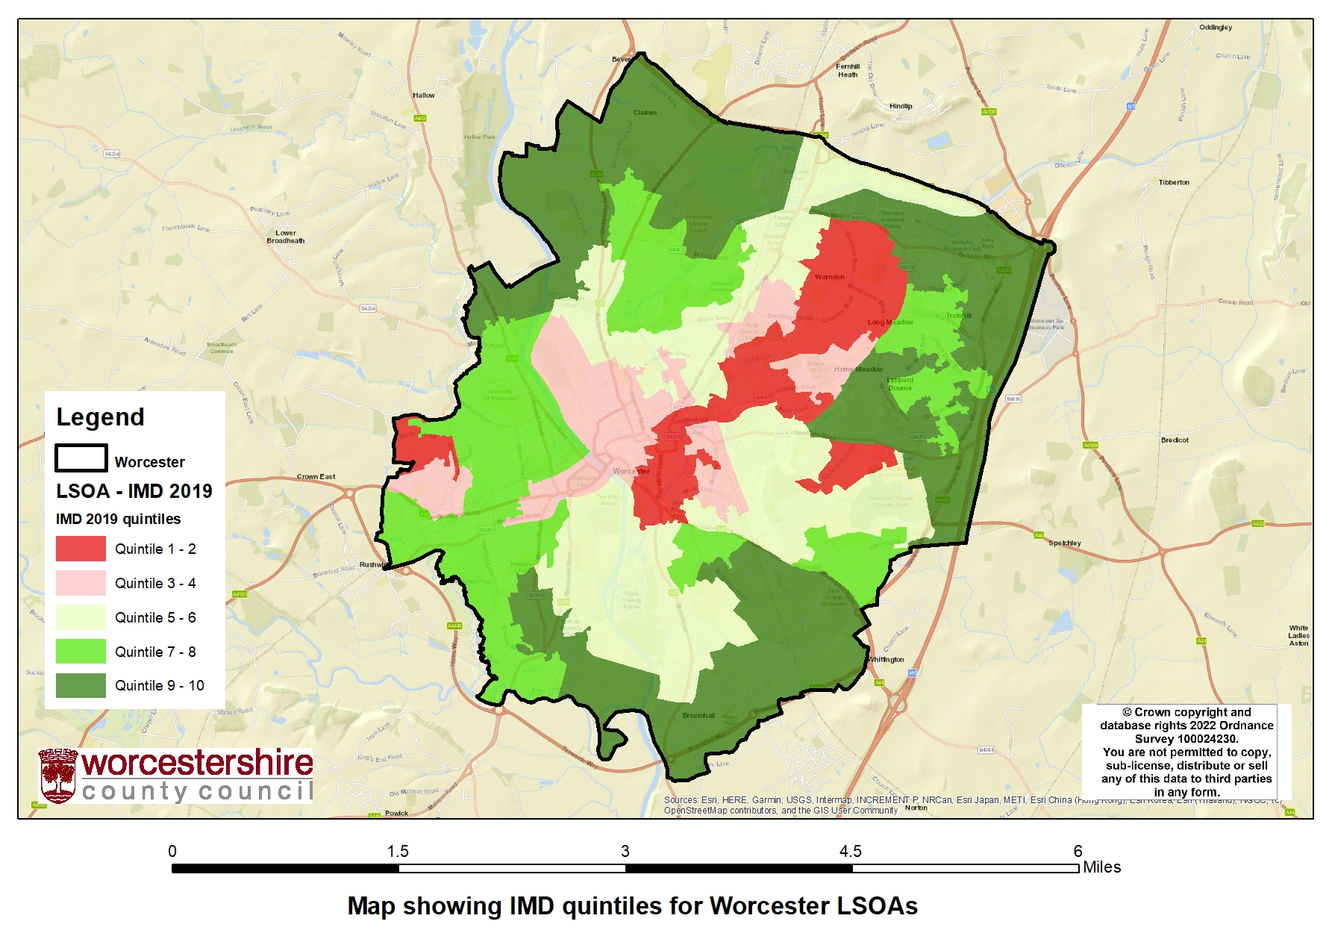
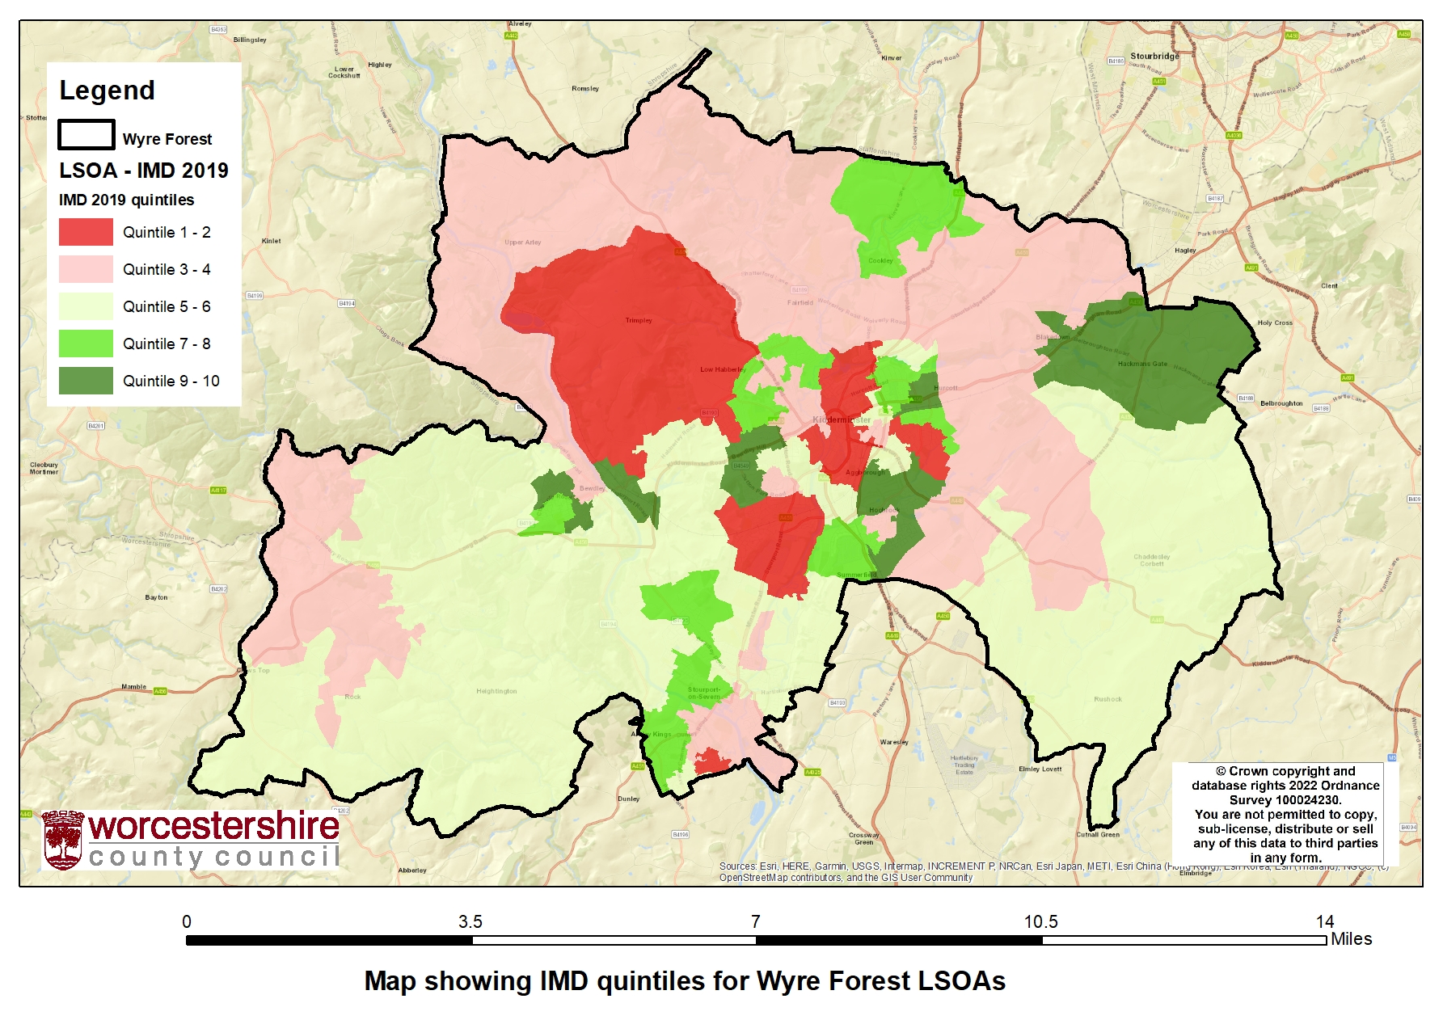
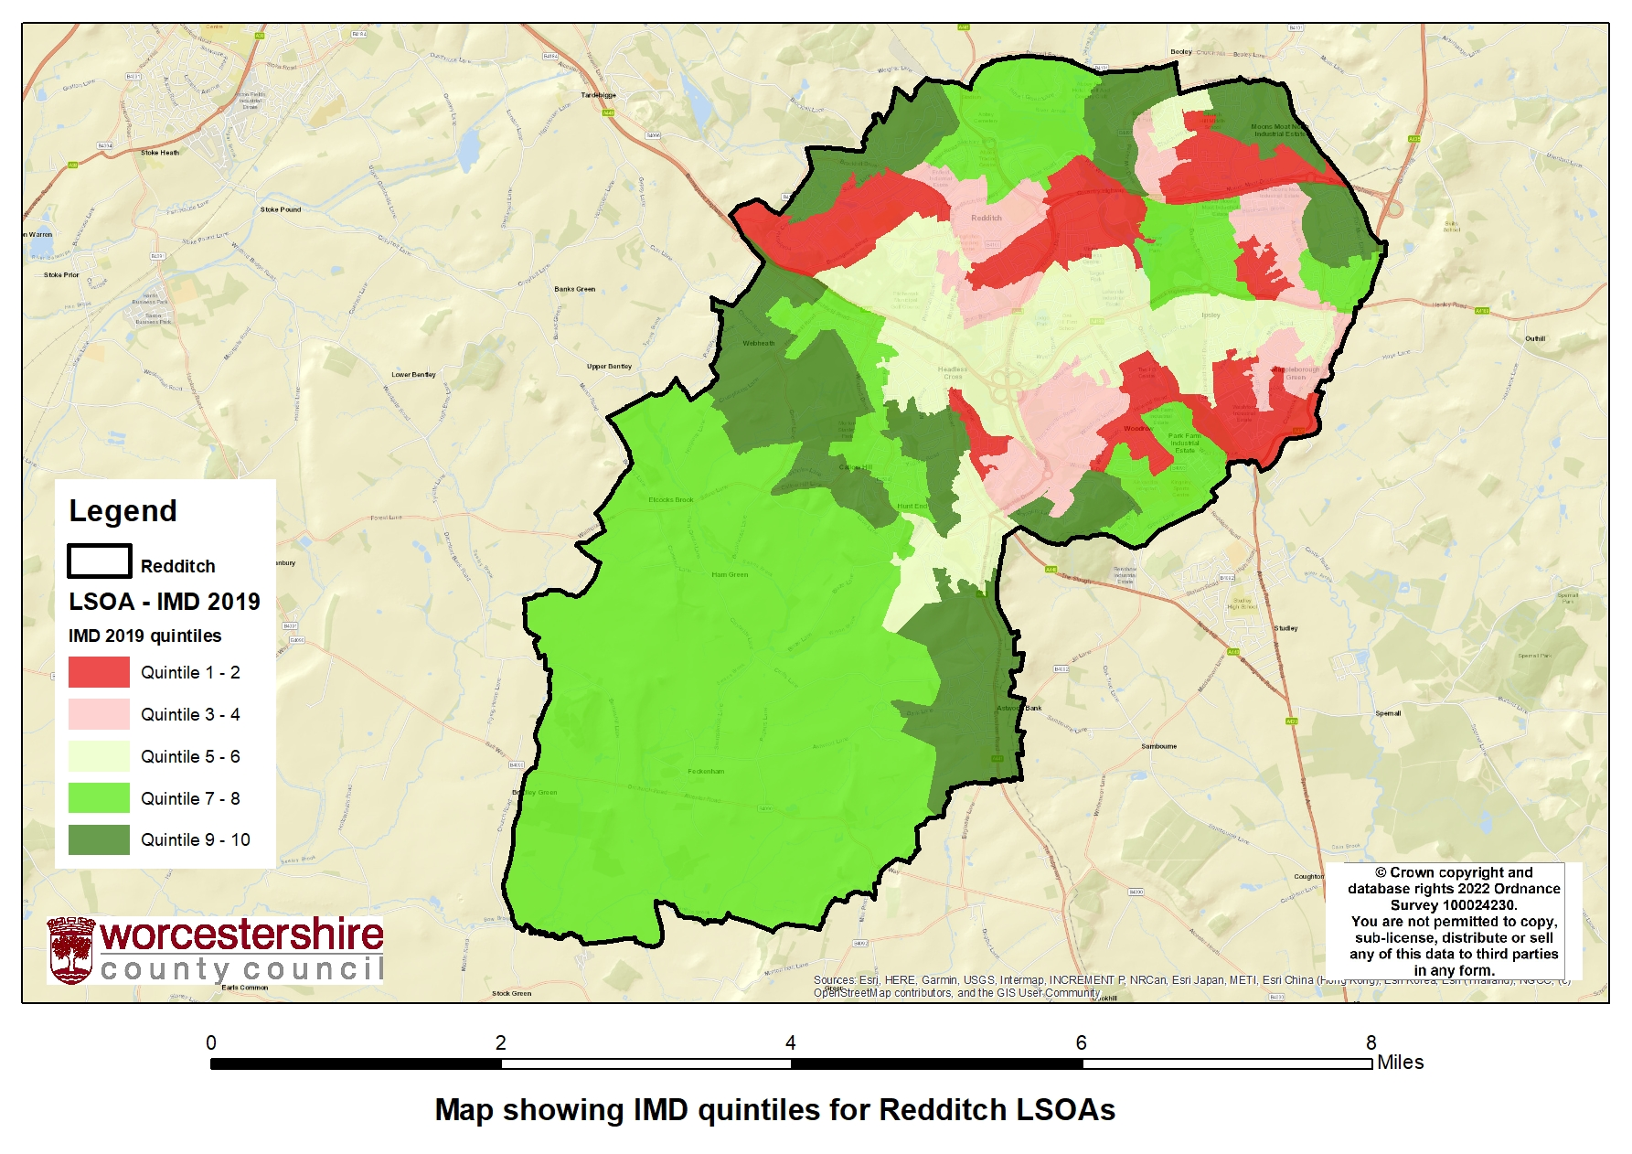
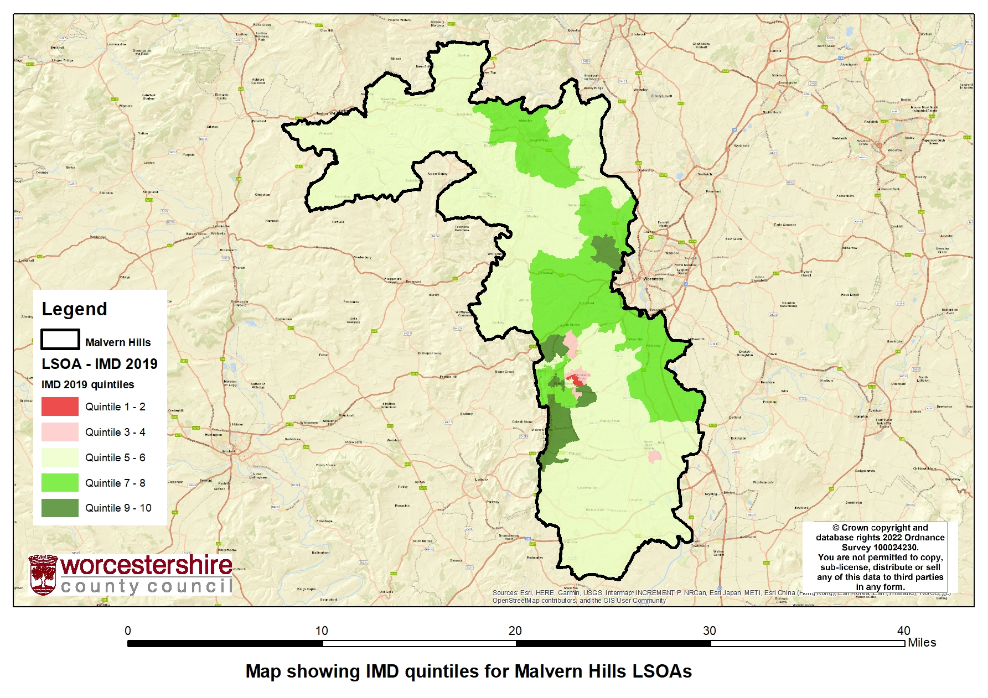
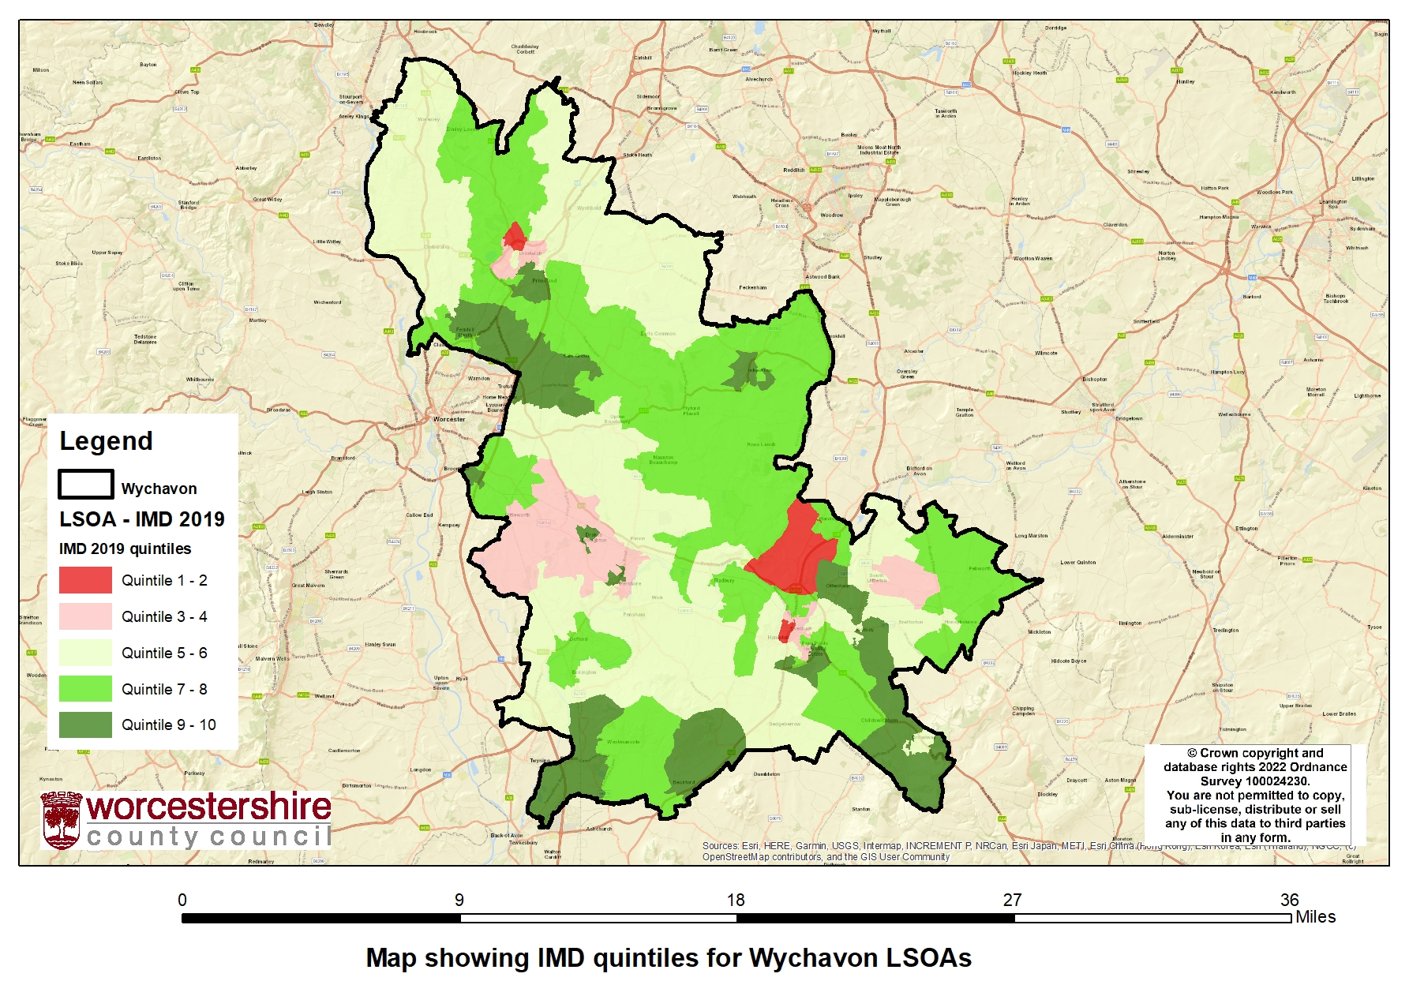
Maps Showing IMD Quintiles for Districts in Worcestershire
Ensuring that tackling health inequalities is everyone’s business

Slide 20
Map Showing IMD Quintiles for Worcester LSOAs
Worcester City has 4 LSOA’s within the top 20% most deprived areas.
8 LSOAs within the top 10% most deprived areas.
Data from EMIS as from 4th Oct 2024
Total No. Of Children: 25,164
Children in IMD quintile 1: 4,985
19.8% of CYP population live in IMD1
Ensuring that tackling health inequalities is everyone’s business

Slide 21
Map Showing IMD Quintiles for Redditch LSOAs
Redditch has the most LSOA’s within the top 20% most deprived areas.
9 LSOAs in Redditch are within the 20% most deprived areas.
5 LSOAs are within the top 10% most deprived areas.
At the 20% level, Redditch (along with Wyre Forest) has the highest proportion of population residing in deprived areas.
Data from EMIS as from 4th Oct 2024
Total No. Of Children: 21,363
Children in IMD quintile 1: 5,582
26.1% of CYP population live in IMD1
Ensuring that tackling health inequalities is everyone’s business

Slide 22
Map Showing IMD Quintile for Wyre Forest LSOAs
Wyre forest (along with Redditch) has the most LSOA’s within the top 20% most deprived areas.
9 LSOAs in Wyre forest are within the 20% most deprived areas.
5 LSOAs are within the top 10% most deprived areas.
At the 20% level, Wyre Forest (along with Redditch) has the highest proportion of population residing in deprived areas.
Data from EMIS as from 4th Oct 2024
Total No. Of Children: 21,287
Children in IMD quintile 1: 5,839
27.4% of CYP population live in IMD1
Ensuring that tackling health inequalities is everyone’s business

Slide 23
Map Showing IMD Quintiles for Wychavon LSOAs
4 LSOAs in Wychavon are within 20% most deprived areas in the district.
5.2% of CYP population live in IMD1 in Wychavon with a 0.8% Obesity rate.
Data from EMIS as from 4th Oct 2024
Total No. Of Children: 26,657
Children in IMD quintile 1: 1,379
5.2% of CYP population live in IMD1
Ensuring that tackling health inequalities is everyone’s business

Slide 24
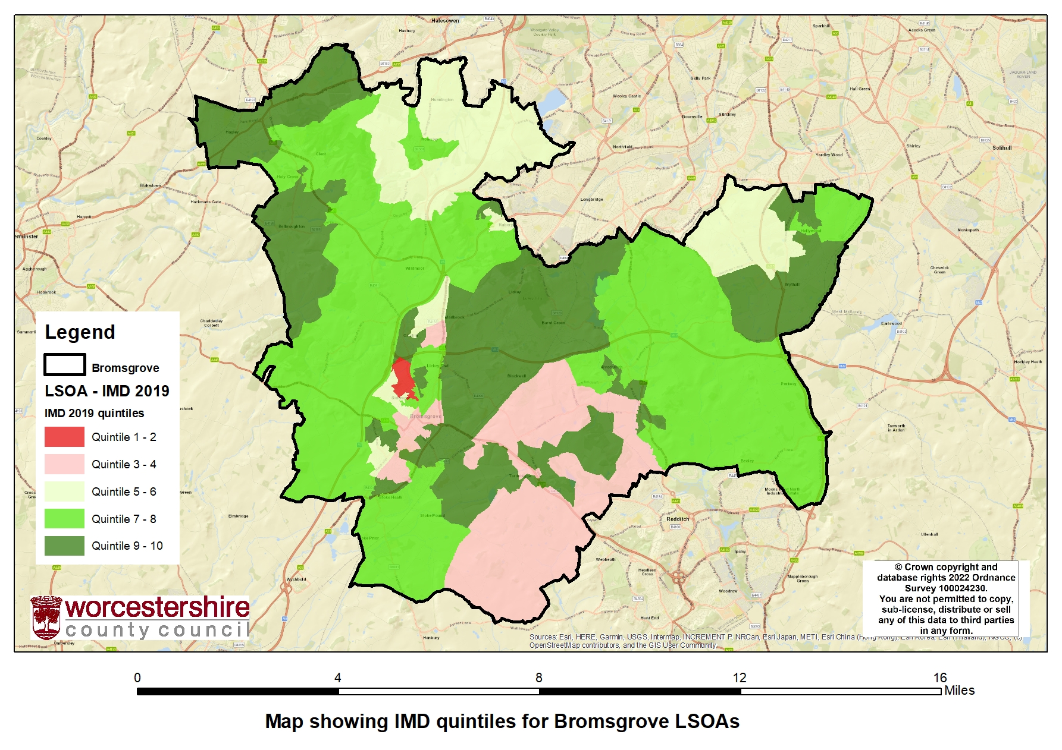
Map Showing IMD Quintiles for Bromsgrove LSOAs
1 LSOAs in Bromsgrove (Bromsgrove 010D) is within top 20% most deprived areas in the district.
7.4% of CYP population lives in IMD1 in Bromsgrove with 0.8% Obesity rate
Data from EMIS as from 4th Oct 2024
Total No. Of Children: 15,884
Children in IMD quintile 1: 1,173
7.4% of CYP population live in IMD1
Ensuring that tackling health inequalities is everyone’s business

Slide 25
Map Showing IMD Quintiles for Malvern Hills LSOAs
1 LSOAs in Malvern Hills is within the top 20% most deprived areas in the district.
Data from EMIS as from 4th Oct 2024
Total No. Of Children: 7,288
Children in IMD quintile 1: 868
11.9% of CYP population live in IMD1
Ensuring that tackling health inequalities is everyone’s business

Slide 26
Spotlight on the 5 Clinical Areas for CYP
Ensuring that tackling health inequalities is everyone’s business

Slide 27
Overview:
What does Core20PLUS5 clinical areas look like in H&W?
Herefordshire
4,600 children eligible for free school meals-
3.7% of children in primary school and 4.2% children in secondary school have social, emotional and mental health needs.
1,670 children are recorded as having Asthma
39% of 5 year old have experience with visually dental decay
89 children (0-17) are recorded as having Diabetes
201 children (0-17) are recorded as having Epilepsy
103 children (0-17) are recorded as having depression and 395 as having anxiety
Worcestershire
14,700 children eligible for free school meals-
8,745 children in H&W access mental health services as of March 2024
613 children are obese
293 children with Diabetes
403 children with Epilepsy
4,418 children with Asthma
198 children with Tooth decay
Inequalities
Source: Taurus Healthcare PHM profile
Ensuring that tackling health inequalities is everyone’s business

Slide 28
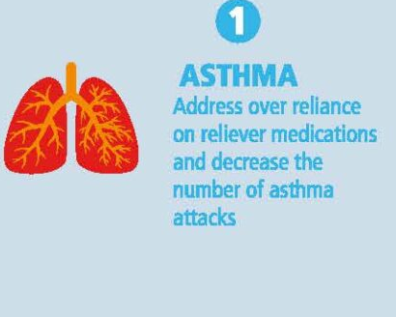
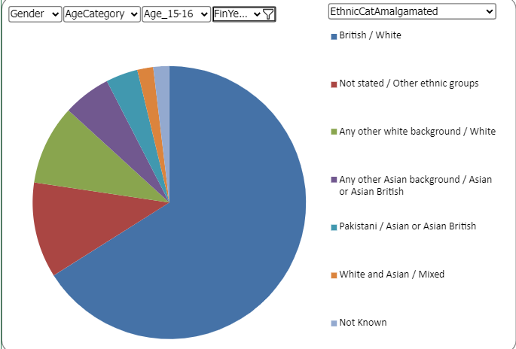
5 Key Clinical Areas of CYP Health Inequalities: Asthma
National Deliverable | Current Position | Plans for Improvement
 | Herefordshire recorded 45 per 100,000 and Worcestershire recorded125 per 100,000 hospital admissions for under 19s. Not statistically different to West Midlands or England (Source: Fingertips 2022/23, data will be updated as it becomes available) Asthma A&E Attendance | Asthma training to be delivered in schools in Herefordshire. Asthma policy being developed to support schools. Working with a small number of housing associations in Worcestershire to identify CYP with asthma living in poor housing conditions which could lead to an exacerbation (pilot). Development of diagnosis in Primary Care.
Ensuring that tackling health inequalities is everyone’s business

Slide 29
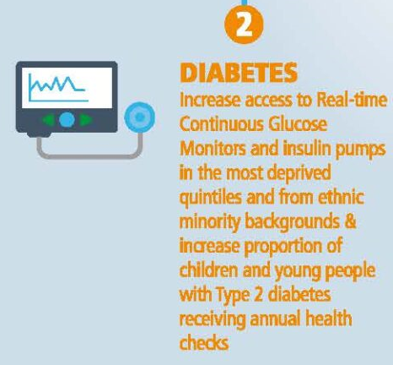
5 Key Clinical Areas of CYP Health Inequalities: Diabetes
National Deliverable | Current Position | Plans for Improvement
 | Worcestershire has 60 per 100,000 Herefordshire 83.4 per 100,000 hospital admissions for under 19s. (Source: Fingertips 2022/23, data will be updated as it becomes available) Acute trusts continue to provide access to continuous glucose monitoring and pump therapy for any child living with T1 diabetes. Delivery of pilot youth worker service in Herefordshire to support wellbeing needs of YP living with T1 diabetes. Signposting to activities and third party support within Herefordshire. | Provision of training in primary care to ensure early access to diagnosis for any child who displays symptoms of T1 diabetes. Promotion of T1 diabetes symptoms in all schools.
Ensuring that tackling health inequalities is everyone’s business

Slide 30
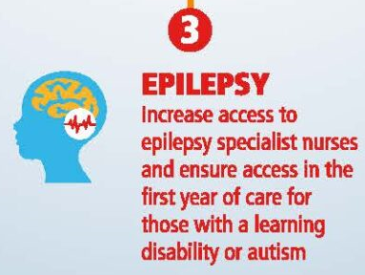
5 Key Clinical Areas of CYP Health Inequalities: Epilepsy
National Deliverable | Current Position | Plans for Improvement
 | Current recruitment of epilepsy specialist nurse in the Health and Care Trust to deliver care for CYP with complex needs. | Development of care pathways to ensure equitable access to diagnosis and referral to appropriate care for children with complex needs.
 | Delivery of youth worker pilot for Epilepsy in Herefordshire as above. | Delivery of psychology service pilot in Worcestershire and Herefordshire to support mental health needs for any child living with epilepsy.
Ensuring that tackling health inequalities is everyone’s business

Slide 31
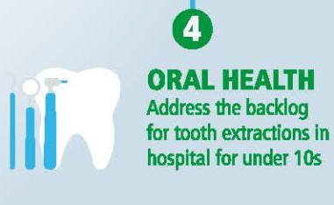
5 Key Clinical Areas of CYP Health Inequalities: Oral Health
National Deliverable | Current Position | Plans for Improvement ICB Dental Recovery Plan 2024-2027
 | Oral health data of 5 year old children can be used to identify geographic areas which have poorer oral health. Those areas with poorer oral health should be prioritised for action to improve access to NHS primary care dentistry. People who have the greatest oral health needs live in the more deprived areas. The more deprived areas with the lowest dental access rates should be prioritised for action to improve access to NHS primary care dentistry. the ICB’s main focus is to improve access to NHS dentistry, achieving pre pandemic levels. The oral health work such as early years tooth brushing etc, are council/public health lead. Considering the Core20PLUS5 CYP focus of Oral health data from the National Dental Epidemiology Programme survey of 5-year-old children (2021/22) Office for Health Improvement and Disparities. 2022 National Dental Epidemiology Programme survey of 5-year-old children. Available at https://www.gov.uk/government/statistics/oral-health-survey-of-5-year-old-children-2022/national-dental-epidemiology-programme-ndep-for-england-oral-health-survey-of-5-year-old-children-2022 Achievements so far; Two new dental practices commissioned in Hereford City. Implementation of minimum UDA rate and New Patient Premium Proposal approved for a local Dental Training Centre Two corporate dental practices (1 in Hereford and 1 in Worcester) have changed ownership in March 2024. Data is showing an increase in activity. | Finalised, awaiting sign off. The ICB’s main focus is to improve access to NHS dentistry, achieving pre pandemic levels. The priority areas as set out in the ICBs Dental Recovery Plan will significantly contribute to improving the dental health outcomes of children, and so preventing tooth decay. The oral health work such as early years tooth brushing etc, are council/public health lead. Considering the Core20Plus5 CYP focus of The Purpose of the plan is to ensure that our population across Herefordshire and Worcestershire have access to sustainable NHS dental prevention, care and treatment. This will be delivered through a variety of commissioning approaches, underpinned by population need, strong engagement with the dental profession and service users, and delivery of high-quality patient care and value for money for the NHS The plan has 4 key priorities: Improving equitable access to dental services Increasing focus on prevention & reducing oral health inequalities Developing the dental workforce & support retention Strengthening relationships with local communities Population need and priority wards have been identified by the Dental Services Equity Audit based on IMD Access data (both adults and children) % decayed, missing, filled teeth (dmft) data Assessment of commissioned activity The ICB Dental Recovery Plan is currently going through engagement and governance. Due to be signed off December 2024. Out Of Hours and Urgent Care Office of West Midlands will be carrying out a review of Out of Hours and Urgent Care in dentistry across the West Midlands on behalf of the 6 ICBs. Additional Work Exploring implementing a Health Inequalities Premium Extending current and exploring other flexible commissioning to target vulnerable groups with high need
Ensuring that tackling health inequalities is everyone’s business

Slide 32
Worcestershire
In line with the national trend:
0-5 dental health is worse in more deprived areas (some protective effect of fluoride).
The most deprived areas of Worcestershire have:
Higher rates of children with dental decay and tooth loss.
Ensuring that tackling health inequalities is everyone’s business

Slide 33
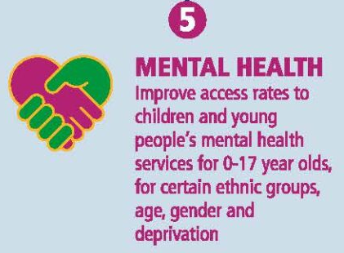
5 Key Clinical Areas of CYP Health Inequalities: Mental Health
National Deliverable | Current Position | Plans for Improvement
 | As of March 2024 reporting Herefordshire and Worcestershire achieved an access rate of 8,745 over the previous 12-month period, against a target of 11,865 set nationally, leaving a deficit of 3,120 against the national ambition. This position has improved from April to July 2024 to 9,265 against the same target, leaving a deficit of 2,600. The access rate in Herefordshire and Worcestershire is currently made up primarily of interventions and activity from the following services: Herefordshire and Worcestershire Health and Care NHS Trust (HWHCT) CAMHS (circa 3,250 per year) MHST (circa 1,800 per year) Reach4Wellbeing (circa 500 per year) Kooth (sub-contracted) (circa 2,000 per year) CLD Trust (circa 1,200 per year) Because the metric only counts each individual patient once, regardless of whether they attend multiple services / pathways, it is difficult for precise numbers to be accounted for by individual provider. The above totals are therefore approximate and will not necessarily be an accurate reflection of all activity undertaken by the different teams. | Four major actions will be taken to address the access deficit for children and young people in Herefordshire and Worcestershire: Commission Lumi Nova, which is a digital treatment platform aimed at children aged 7-12 in the form of a video game that facilitates graded exposures and psychoeducation Act On It is a school-based service across 14 schools and colleges in Worcestershire, supporting children and young people utilising a combination of group-based psychoeducation programmes and one-to-one Social Prescribing Link Worker support. Delivered as a collaboration between Onside Advocacy and Action for Children Re-procure emotional wellbeing and mental health services: Currently the Preventative and Early Intervention offer for children and young people is delivered by three different providers across Herefordshire and Worcestershire Following the restoration of Carenotes and a review of options to increase access and capture of activity within HWHCT services, including discussion with other provider Trusts, a trajectory has been established for increased access.
Ensuring that tackling health inequalities is everyone’s business

