Slide 1

AI and Ambient Scribe AI update
ELT Deep Dive 24 June 2025

Slide 2

AI is ‘everywhere, all at once’
“The future of AI is not about replacing humans, it’s about augmenting human capabilities.”
Sundar Pichai, CEO of Google
“Artificial Intelligence will evolve to become a superintelligence. We need to be mindful of how it’s developed and ensure that it aligns with humanity’s best interests.”
Bill Gates, Co-founder of Microsoft
Notes:
Never have I seen such a fast pace of technological change and adoption of technology in healthcare

Slide 3
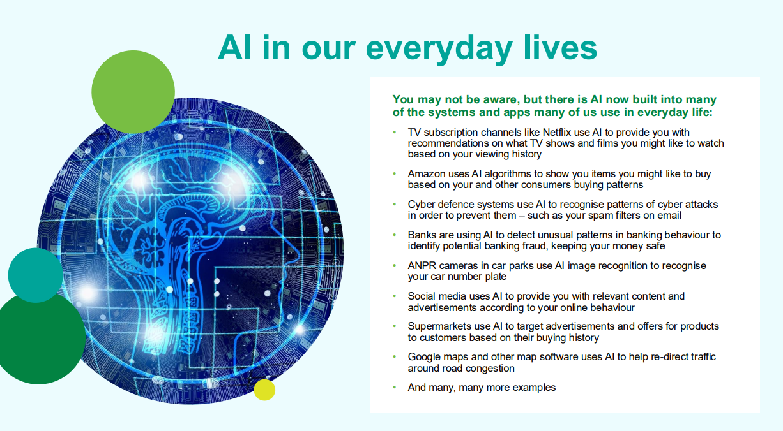

Slide 4
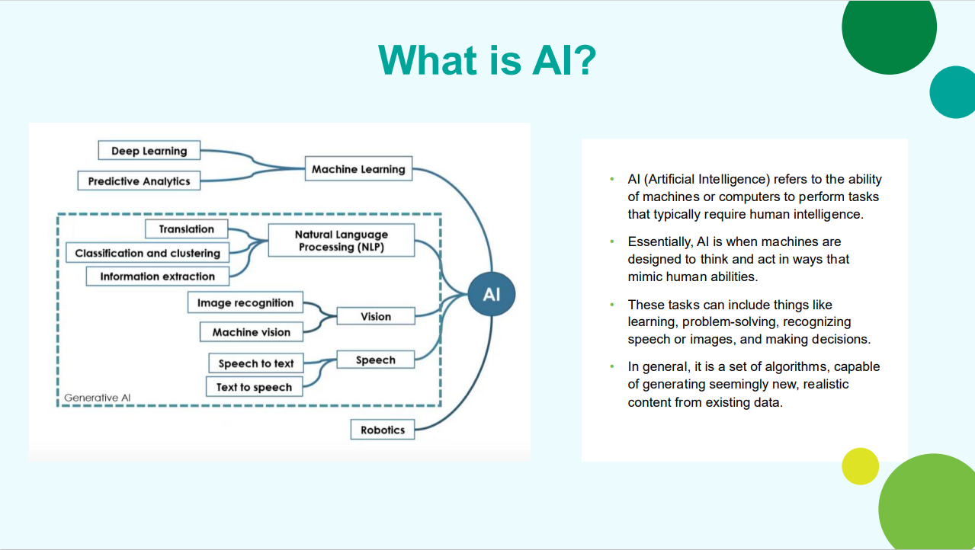
If you are interested, this is a great overview video intro to AI in Healthcare:
Understanding AI in healthcare

Slide 5
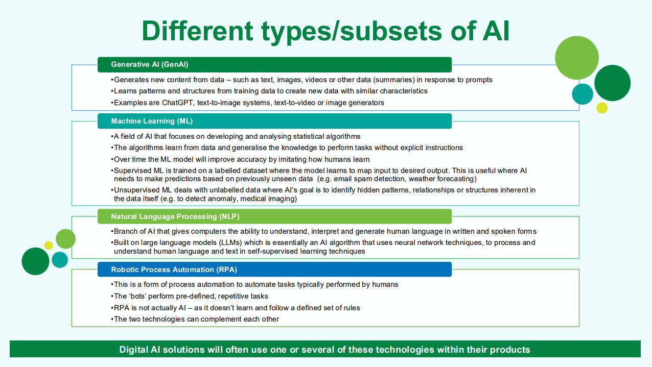

Slide 6
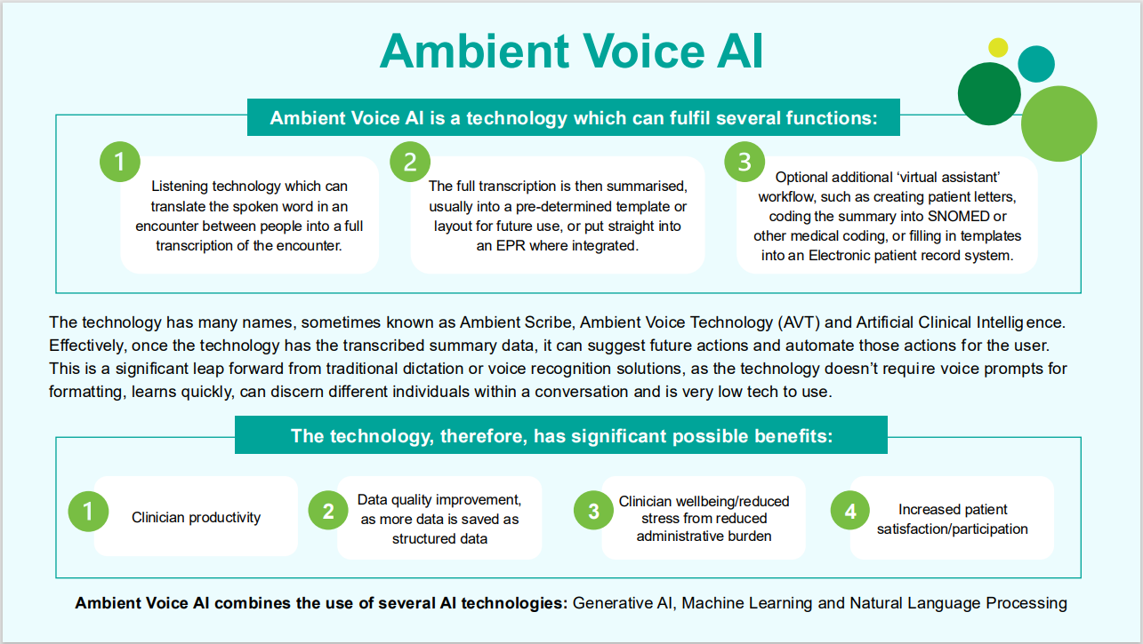

Slide 7
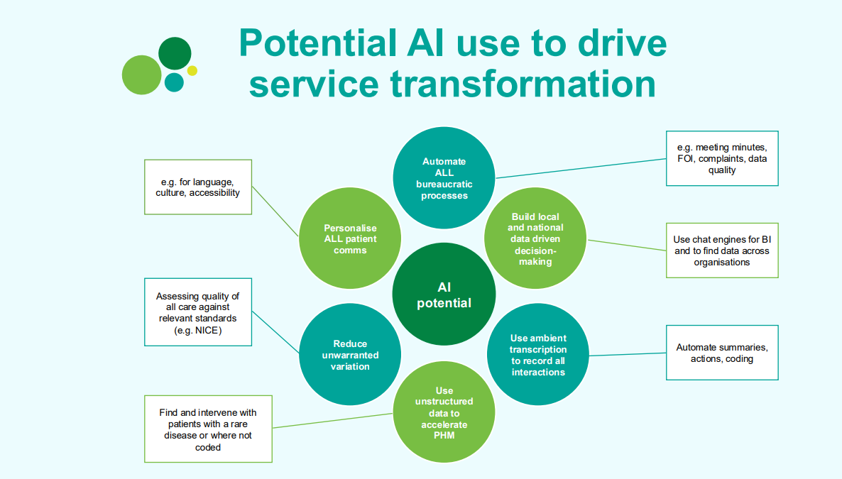

Slide 8
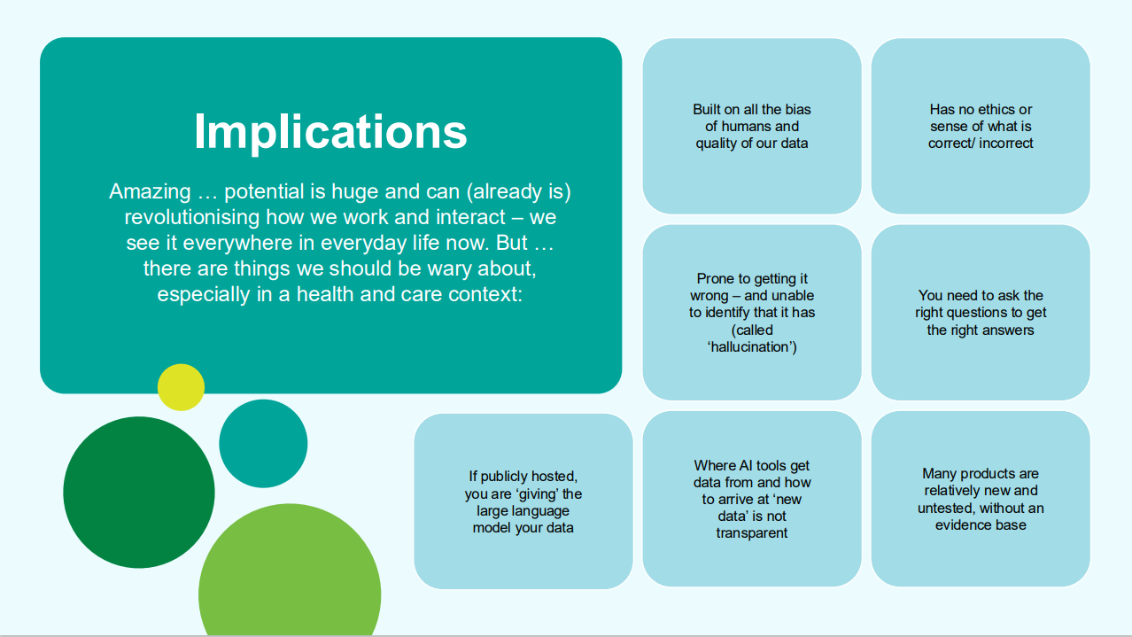

Slide 9


Slide 10
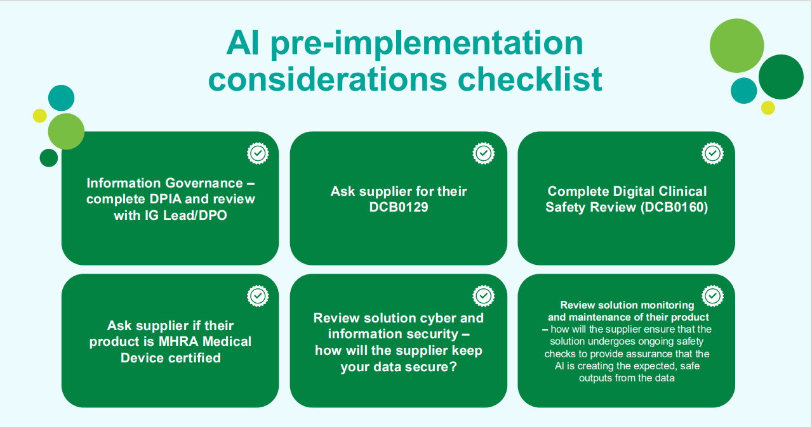

Slide 11
Context – where are we now
Nationally
National AI Ambassadors network in place
More general national resources available to support AI adoption and implementation within Healthcare on Futures: Understand AI - AI Virtual Hub - Futures
Importance of assurance and digital clinical safety including where MHRA type 1 medical device accreditation is required
MHRA working on specific guidance in relation to AI regulation with UK government and health sectors
Training, guidance, views and groups popping up all over
Regional Midlands Automation & AI group
AI across ICS
Trusts building own policies and governance processes
Subject of ICS wide Technical design authority (TDA) and ICS Digital, Data and Technology programme board but no clear framework agreed
Each organisation building/shaping knowledge and capability in this area
Significant national focus on Ambient Scribe with National guidance on Ambient Scribe adoption: Adopting ambient scribing products in health and care settings
Expecting some digital funding will be focused on AI

Slide 12
Corporate ICB
Meetings administration
Additional licence cost per user per annum
Learning from pilot:
Only required by those who need to create minutes and actions of meetings
Support chairs of meetings with guidance on how to get the best out of the solution will aid in it’s productivity, good practice and security for set up
Pilot of Microsoft Teams premium to create a summary/recap and actions from recording taken place
Support administrators of meetings in good practice and etiquette for set up and how to use it – guidance in draft, being reviewed
Committee meetings/public meetings often more complex and detailed notes required – trialling Microsoft CoPilot for this purpose, will bring findings back
The capability can increase meeting security as well as productivity
AI Governance policy
Drafted and will be circulated for comment prior to approval
We will need to agree on governance structure (like we have for IG) for AI use and clinical safety to be approved
Currently in phased roll out

Slide 13
Corporate ICB
Key takeaways
Our staff need to be aware of the guidance in their own use of AI in support of their own work and if they are involved in supporting procurement or use of any AI solution
Other AI use cases
We’ve pulled together many sources of guidance and information into a single page to support AI which includes
Ambient AI in Health and Care overview and guidance framework for staff AI and Ambient AI in Healthcare Guidance for staff May 2025
This has gone out on The Hub as a news article and been circulated in GPU to our practices
AI and Ambient Scribe information hub on Teamnet (available to all ICS and GP practice staff) - AI and Ambient Scribe information hub
We will work to keep links to further resources up to date and add information/guidance as it becomes available
We will do further awareness raising as part of Summer of Learning
We’ve also shared with ICS partners for their re-use
CHC IEG 4 implementation
National Guidance came last week to say that Ambient Scribe products that summarise need to be MHRA medical device type 1 approved – still guidance but clear steer, widely publicised
Working with IEG4 to see if this can be achieved with their current Ambient Scribe 3rd party product
Working with CHC on options to mitigate the risk
Policy will support further when approved

Slide 14
ICS-wide Ambient AI pilot - clinical
Piloting EPR-integrated Ambient Scribe product across Primary Care, Acute and community
Only one of a few pilots we are aware of using an EPR-integrated approach and featuring multiple care settings
Evaluation resource supported by University of Edinburgh and University of Worcester
Wye Valley has already started their pilot including initial evaluation phase and technical integration. We have 5 GP practices due to go live with pilots early July.
Product is T-Pro which has MHRA Medical Device type 1 registration and is a well-established medical voice-dictation product
Given announcement re MHRA type 1 medical device requirement, working with Trusts and GP practices to verify if products already in use (albeit most using ‘free trials’) have this accreditation
Market place is very fluid– new products coming to market from existing and new suppliers every week. Working with suppliers for Primary Care to ensure suitable IG, clinical safety (including MHRA) and cyber security are in place

Slide 15
Key Takeaways for You
Do not use Generative AI with confidential data AT ALL
Think first before you use AI – is it approved, is it safe, is it ethical?
Check available guidance in trusted resources
For any clinical use, MHRA registration and DCB0160 required
Ensure you review any AI generated content before you use it – you are accountable
Consider where the data comes from – will it be accurate, will it be biased?
Be open & clear about your use of AI – let people know in meetings what it will be used for, or cite that you have used it to create content

Slide 16
Links to guidance to support AI Supplier Assurance
NHS Digital Technology Assessment criteria (DTAC) Digital Technology Assessment Criteria (DTAC) Key tools and information
Within H&W ICB, we are using a Midlands Assurance framework questionnaire to cover DTAC which is available from the ICB Digital team
NHS England » Guidance on the use of AI-enabled ambient scribing products in health and care settings
NHS England » Digital clinical safety assurance
Introduction to AI assurance - GOV.UK

Slide 17
Some useful reading/references
AI Playbook for the UK Government - GOV.UK
A guide to using artificial intelligence in the public sector - GOV.UK (www.gov.uk)
The NHS AI Lab - NHS Transformation Directorate (england.nhs.uk)
The full "Buyer's guide to AI in health and care" - NHS Transformation Directorate (england.nhs.uk)
Artificial intelligence | ICO
Thinking about the security of AI systems - NCSC.GOV.UK
Artificial intelligence - NCSC.GOV.UK
ChatGPT and LLMs: what's the risk - NCSC.GOV.UK
bma-principles-for-artificial-intelligence-ai-and-its-application-in-healthcare.pdf
BMA Use of AI in General Practice

